Slide 1

Compilers Theory
Lab 4

Slide 2
Quiz
30 minutes

Slide 3
Important Note
Milestone 1 Discussion:
Next Week

Slide 4
REMINDER!
Milestone 1 deliverables:
A printed document that consists of three section:
  All regular expressions of tiny language token classes.
  All DFAs “for token classes” needed to construct tiny language.
  A copy of the implementation of the Rynix language scanner.
Implement a full scanner for Rynix language. Your interface should show:
  A Text area for typing in the Rynix code
  The Errors List
  Lexeme-to-Token Table.
You must submit the document and the source code of the scanner before the discussion

Slide 5
Agenda
Subset Construction
DFA Minimization
Examples on Subset Construction & Minimization of DFA
Additional Example (Self study)

Slide 6
Subset Construction

Slide 7
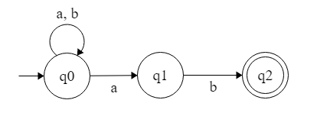
Subset Construction
Conversion from NFA N< Q, ∑, q0, δ, F > to
DFA D< Q’, ∑, q0, δ’, F’ >
Step1: Construct a transition table
State | a | b
q0 | q0,q1 | q0
q1 | φ | q2
q2 | φ | φ
Notes:
Step1
Construct a transition table showing all reachable states for every state for every input signal.
Suppose there is an NFA N < Q, ∑, q0, δ, F > which recognizes a language L. Then the DFA D < Q’, ∑, q0, δ’, F’ > can be constructed for language L as:
Step 1: Initially Q’ = ɸ.
Step 2: Add q0 to Q’.
Step 3: For each state in Q’, find the possible set of states for each input symbol using transition function of NFA. If this set of states is not in Q’, add it to Q’.
Step 4: Final state of DFA will be all states with contain F (final states of NFA)

Slide 8
Subset Construction cont.
Step2: Filling Table for DFA D< Q’, ∑, q0, δ’, F’ >
Q’ = {q0}
Now { q0, q1 } will be considered as a single state. As its entry is not in Q’, add it to Q’.
Q’ = { q0, { q0, q1 } }
State | a | b
q0 | {q0,q1} | q0
Notes:
Step 1: Initially Q’ = ɸ.
Step 2: Add q0 to Q’.
Step 3: For each state in Q’, find the possible set of states for each input symbol using transition function of NFA. If this set of states is not in Q’, add it to Q’.
Step 4: Final state of DFA will be all states with contain F (final states of NFA)

Slide 9
Subset Construction cont.
δ’ ( { q0, q1 }, a ) = δ ( q0, a ) ∪ δ ( q1, a ) = { q0, q1 }
δ’ ( { q0, q1 }, b ) = δ ( q0, b ) ∪ δ ( q1, b ) = { q0, q2 }*
State | a | b
q0 | q0,q1 | q0
q1 | φ | q2*
q2* | φ | φ
State | a | b
q0 | {q0,q1} | q0
{q0,q1} | {q0,q1} | {q0,q2}*
Notes:
Now, moves from state { q0, q1 } on different input symbols are not present in transition table of DFA, we will calculate it like:
δ’ ( { q0, q1 }, a ) = δ ( q0, a ) ∪ δ ( q1, a ) = { q0, q1 }
δ’ ( { q0, q1 }, b ) = δ ( q0, b ) ∪ δ ( q1, b ) = { q0, q2 }
Now we will update the transition table of DFA.

Slide 10
Subset Construction cont.
Final state of DFA will be state which has q2* as its component i.e., { q0, q2 }*
State | a | b
q0 | q0,q1 | q0
q1 | φ | q2*
q2 | φ | φ
State | a | b
q0 | {q0,q1} | q0
{q0,q1} | {q0,q1} | {q0,q2}*
{q0,q2}* | {q0,q1} | q0
Notes:
Now { q0, q2 } will be considered as a single state. As its entry is not in Q’, add it to Q’.
So Q’ = { q0, { q0, q1 }, { q0, q2 } }
Now, moves from state {q0, q2} on different input symbols are not present in transition table of DFA, we will calculate it like:
δ’ ( { q0, q2 }, a ) = δ ( q0, a ) ∪ δ ( q2, a ) = { q0, q1 }
δ’ ( { q0, q2 }, b ) = δ ( q0, b ) ∪ δ ( q2, b ) = { q0 }
Now we will update the transition table of DFA.
As there is no new state generated, we are done with the conversion. Final state of DFA will be state which has q2 as its component i.e., { q0, q2 }

Slide 11
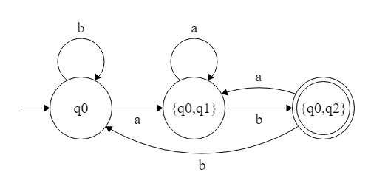
Subset Construction cont.
Answer:
State | a | b
q0 | {q0,q1} | q0
{q0,q1} | {q0,q1} | {q0,q2}*
{q0,q2}* | {q0,q1} | q0
Notes:
Q’ = { q0, { q0, q1 }, { q0, q2 } }
∑ = ( a, b )
F = { { q0, q2 } } and transition function δ’

Slide 12
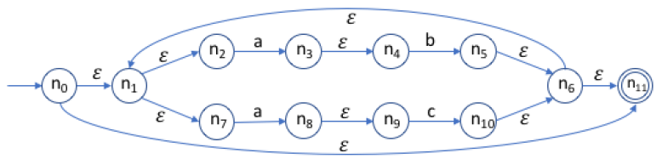
Example 1
Convert the following regular expression to an NFA then to a minimized DFA.
RE= (ab|ac)*
Solution:-
1- Convert RE to NFA using Thompson’s algorithm.
Notes:
Start
0,1,2,7,11
A
2 -> 3,4
7 -> 8,9
B
4 -> 1,2,5,6,7,11
c
9 -> 1,2,6,7,10,11

Slide 13
Example 1
Hints:
Start state:
  = {0,1,2,7,11}*
Build the following table:
Sigma | Appears | Goes to
a | 2 | {3,4}
 | 7 | {8,9}
b | 4 | {1,2,5,6,7,11}*
c | 9 | {1,2,6,7,10,11}*
Notes:
Start
0,1,2,7,11
A
2 -> 3,4
7 -> 8,9
B
4 -> 1,2,5,6,7,11
c
9 -> 1,2,6,7,10,11

Slide 14
Example 1 cont.
2- convert from NFA to DFA using subset construction method.
Start state = {0,1,2,7,11}*
Sigma | Appears | Goes to
a | 2 | {3,4}
 | 7 | {8,9}
b | 4 | {1,2,5,6,7,11}*
c | 9 | {1,2,6,7,10,11}*
DFA | NFA | δ(q,a) | δ(q,b) | δ(q,c)
→d0* | →{0, 1, 2, 7, 11}* | {3, 4, 8, 9} | Φ | Φ
d1 | {3, 4, 8, 9} | Φ | {1, 2, 5, 6, 7, 11}* | {1, 2, 6, 7, 10, 11}*
Φ | Φ | Φ | Φ | Φ
d2* | {1, 2, 5, 6, 7, 11}* | {3, 4, 8, 9} | Φ | Φ
d3* | {1, 2, 6, 7, 10, 11}* | {3, 4, 8, 9} | Φ | Φ

Slide 15
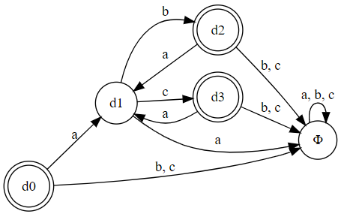
Example 1 cont.
2- convert from NFA to DFA using subset construction method.
RE= (ab|ac)*
DFA | δ(q,a) | δ(q,b) | δ(q,c)
→d0* | d1 | Φ | Φ
d1 | Φ | d2 | d3
Φ | Φ | Φ | Φ
d2* | d1 | Φ | Φ
d3* | d1 | Φ | Φ

Slide 16
DFA Minimization

Slide 17
Example 1 cont.
3- convert from DFA to Minimized DFA.
0-Equivalence: {d1, Φ} {d0, d2, d3}
1-Equivalence: {d1} {Φ} {d0, d2, d3}
2-Equivalence: {d1} {Φ} {d0, d2, d3}
DFA | δ(q,a) | δ(q,b) | δ(q,c)
→d0* | d1 | Φ | Φ
d1 | Φ | d2 | d3
Φ | Φ | Φ | Φ
d2* | d1 | Φ | Φ
d3* | d1 | Φ | Φ
Minimized DFA | DFA | δ(q,a) | δ(q,b) | δ(q,c)
→d0* | →d0, d2, d3* | d1 | Φ | Φ
d1 | d1 | Φ | d0, d2, d3* | d0, d2, d3*
Φ | Φ | Φ | Φ | Φ

Slide 18
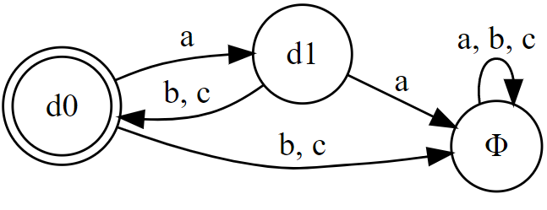
Example 1 cont.
3- convert from DFA to Minimized DFA.
Minimized DFA | DFA | δ(q,a) | δ(q,b) | δ(q,c)
→d0* | →d0, d2, d3* | d1 | Φ | Φ
d1 | d1 | Φ | d0, d2, d3* | d0, d2, d3*
Φ | Φ | Φ | Φ | Φ
DFA | δ(q,a) | δ(q,b) | δ(q,c)
→d0* | d1 | Φ | Φ
d1 | Φ | d0 | d0
Φ | Φ | Φ | Φ

Slide 19
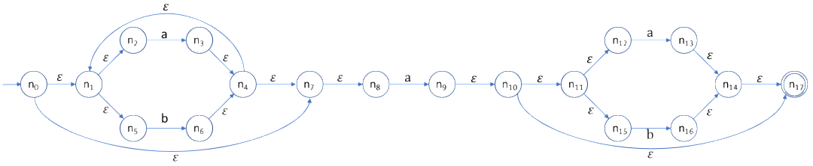
Example 2
Convert the following regular expression to an NFA then to a minimized DFA.
RE= (a | b)* a (a | b | 𝜀 )
Solution:-
1- Convert RE to NFA using Thompson’s algorithm.
Notes:
Start
0,1,2,5,7,8
A
2 -> 1,2,3,4,5,7,8
8-> 9,10,11,12,15,17
12-> 13,14,17
b
5 -> 1,2,4,5,6,7,8
15 -> 14,16,17

Slide 20
Example 1
Hints:
Start state:
  = {0,1,2,5,7,8}
Build the following table:
Sigma | Appears | Goes to
a | 2 | {1,2,3,4,5,7,8}
 | 8 | {9,10,11,12,15,17}*
 | 12 | {13,14,17}*
b | 5 | {1,2,4,5,6,7,8}
 | 15 | {14,16,17}*
Notes:
Start
0,1,2,7,11
A
2 -> 3,4
7 -> 8,9
B
4 -> 1,2,5,6,7,11
c
9 -> 1,2,6,7,10,11

Slide 21
Example 2
Sigma | Appears | Goes to
a | 2 | {1,2,3,4,5,7,8}
 | 8 | {9,10,11,12,15,17}*
 | 12 | {13,14,17}*
b | 5 | {1,2,4,5,6,7,8}
 | 15 | {14,16,17}*
Start state = {0,1,2,5,7,8}
DFA | NFA | δ(q,a) | δ(q,b)
→d0 | →{0, 1, 2, 5, 7, 8} | {1, 2, 3, 4, 5, 7, 8, 9, 10, 11, 12, 15, 17}* | {1, 2, 4, 5, 6, 7, 8}
d1* | {1, 2, 3, 4, 5, 7, 8, 9, 10, 11, 12, 15, 17}* | {1, 2, 3, 4, 5, 7, 8, 9 10, 11, 12, 13, 14, 15, 17}* | {1, 2, 4, 5, 6, 7, 8, 14, 16, 17}*
d2 | {1, 2, 4, 5, 6, 7, 8} | {1, 2, 3, 4, 5, 7, 8, 9, 10, 11, 12, 15, 17}* | {1, 2, 4, 5, 6, 7, 8}
d3* | {1, 2, 3, 4, 5, 7, 8, 9 10, 11, 12, 13, 14, 15, 17}* | {1, 2, 3, 4, 5, 7, 8, 9, 10, 11, 12, 13, 14, 15, 17}* | {1, 2, 4, 5, 6, 7, 8, 14, 16, 17}*
d4* | {1, 2, 4, 5, 6, 7, 8, 14, 16, 17}* | {1, 2, 3, 4, 5, 7, 8, 9, 10, 11, 12, 15, 17}* | {1, 2, 4, 5, 6, 7, 8}

Slide 22
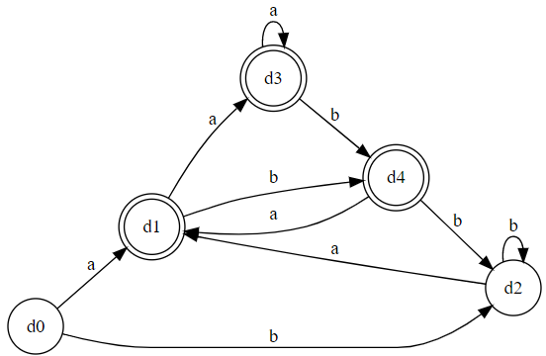
Example 2 cont.
2- convert from NFA to DFA using subset construction method.
DFA | δ(q,a) | δ(q,b)
→d0 | d1 | d2
d1* | d3 | d4
d2 | d1 | d2
d3* | d3 | d4
d4* | d1 | d2

Slide 23
Example 2 cont.
3- convert from DFA to Minimized DFA.
0-Equivalence: {d0, d2} {d1, d3, d4}
1-Equivalence: {d0, d2} {d1, d3} {d4}
2-Equivalence: {d0, d2} {d1, d3} {d4}
DFA | δ(q,a) | δ(q,b)
→d0 | d1 | d2
d1* | d3 | d4
d2 | d1 | d2
d3* | d3 | d4
d4* | d1 | d2
Minimized DFA | DFA | δ(q,a) | δ(q,b)
→d0 | →d0, d2 | d1 | d0
d1* | d1, d3* | d1 | d2
d2* | D4* | d1 | d0

Slide 24
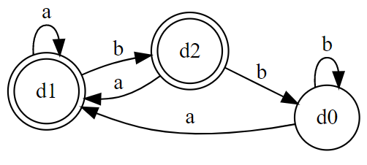
Example 2 cont.
3- convert from DFA to Minimized DFA.
0-Equivalence: {d0, d2} {d1, d3, d4}
1-Equivalence: {d0, d2} {d1, d3} {d4}
2-Equivalence: {d0, d2} {d1, d3} {d4}
DFA | δ(q,a) | δ(q,b)
→d0 | d1 | d0
d1* | d1 | d2
d2* | d1 | d0

Slide 25
Questions?

Slide 26
Additional Example
(Self Study)

Slide 27
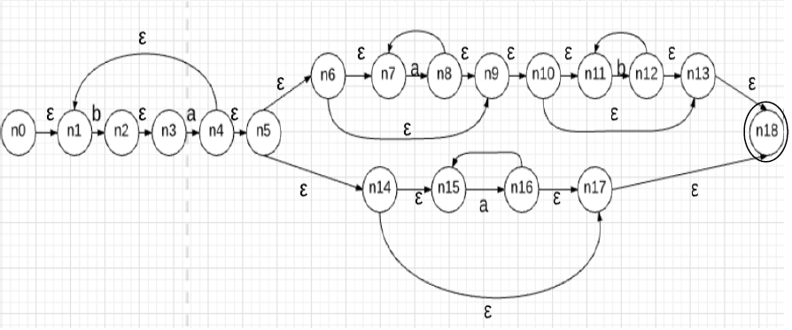
Example 3
Convert the following regular expression to an NFA then to DFA.
RE= (ba)+ (a* b* | a*)

Slide 28
Example 3
Solution:
DFA | NFA | δ(q,a) | δ(q,b)
→d0 | →{0, 1} | Φ | {2,3}
Φ | Φ | Φ | Φ
d1 | {2,3} | {1,4,5,6,7,9,10,11,13,14,15,17,18}* | Φ
d2* | {1,4,5,6,7,9,10,11,13,14,15,17,18}* | {7,8,9,10,11,13,15,16,17, 18}* | {2,3,11,12, 13,18}*
d3* | {7,8,9,10,11,13,15,16,17, 18}* | {7,8,9,10,11,13,15,16,17,18}* | {11,12,13,18}*
d4* | {2,3,11,12, 13,18}* | {1,4,5,6,7,9,10,11,13,14,15,17,18}* | {11,12,13,18}*
d5* | {11,12,13,18}* | Φ | {11,12,13,18}*

Slide 29
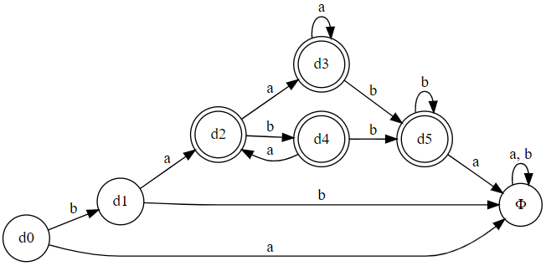
Example 3 cont.
Solution:
DFA | δ(q,a) | δ(q,b)
→d0 | Φ | d1
Φ | Φ | Φ
d1 | d2 | Φ
d2* | d3 | d4
d3* | d3 | d5
d4* | d2 | d5
d5* | Φ | d5

Slide 30
Example 3 cont.
3- convert from DFA to Minimized DFA.
DFA | δ(q,a) | δ(q,b)
→d0 | Φ | d1
Φ | Φ | Φ
d1 | d2 | Φ
d2* | d3 | d4
d3* | d3 | d5
d4* | d2 | d5
d5* | Φ | d5
0-Equivalence: {d0, d1, Φ} {d2, d3, d4, d5}
1-Equivalence: {d0, Φ} {d1} {d2, d3, d4} {d5}
2-Equivalence: {d0} {Φ} {d1} {d2} {d3, d4} {d5}
3-Equivalence: {d0} {Φ} {d1} {d2} {d3} {d4} {d5}
There is no two states at least that are combined together in a set, so the DFA will remain the same.

